Slide 1

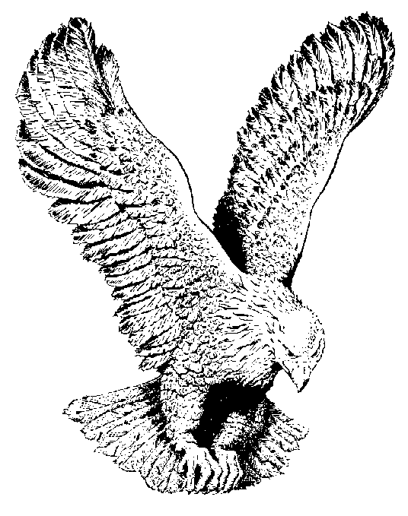
15
WE’RE MARCHING TO ZION
Come, we that love the Lord,
And let our joys be known,
Join in a song with sweet accord,
Join in a song with sweet accord,
And thus surround the throne,
And thus surround the throne.

Slide 2
CHORUS
We’re marching to Zion,
Beautiful, beautiful Zion;
We’re marching upward to Zion,
The beautiful city of God.

Slide 3
Let those refuse to sing
Who never knew our God;
But children of the heavenly King,
But children of the heavenly King,
May speak their joys abroad,
May speak their joys abroad.

Slide 4
The hill of Zion yields
A thousand sacred sweets
Before we reach the heavenly fields,
Before we reach the heavenly fields,
Or walk the golden streets,
Or walk the golden streets.

Slide 5
Then let our songs abound,
And every tear be dry;
We’re marching thru Immanuel’s ground,
We’re marching thru Immanuel’s ground,
To fairer worlds on high,
To fairer worlds on high.

